Slide 1
Imitációs tanulás a DuckieTown környezetben DAgger felhasználásával
Kovács Boldizsár - GVJY8E
Schneider Marcell - DBGYVI
Talpos Norbert - Q2H4XB
Virág József Ádám - U7KC0P

Slide 2
Introduction
Autonomous driving
Data collection, preprocessing
Imitation learning
DAgger
Hyper-optimization

Slide 3
Previous solutions
DAgger & other DAgger implementations
TDK (Lőrincz Zoltán)
DuckieTown documentation
Other DuckieTown projects

Slide 4
System design
Hyperoptimization
Loading data
Running fit of model
Providing DAgger with data
More fitting via DAgger

Slide 5
Database: generating and processing pictures
DuckieTown automatic driver
Manual driving using keyboard
Preprocessing:
HSV filtering: different colours
Cropping
Size reduction

Slide 6
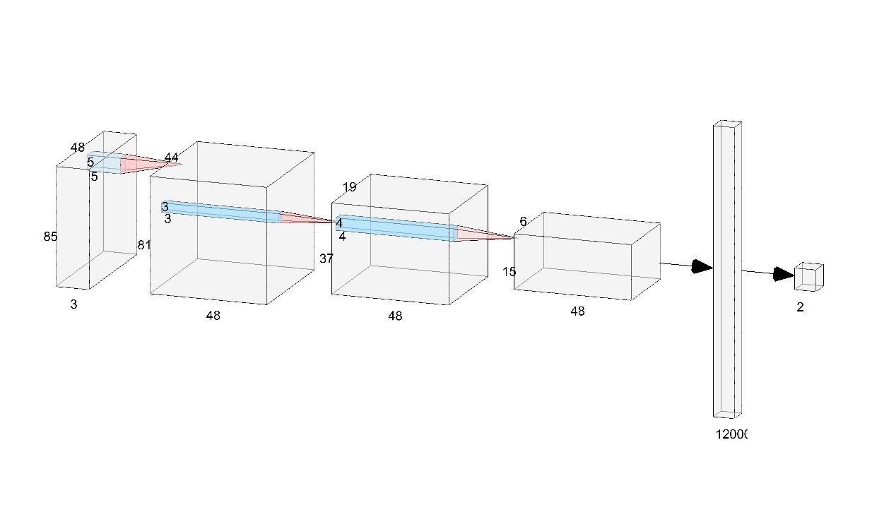
Architecture

Slide 7
Teaching, complications and solutions

